Slide 1
Insights into the Banking dataset
By Valmik Belgaonkar

Slide 2
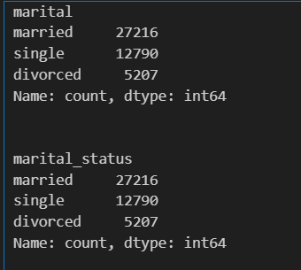
Redundant columns
Firstly, we will need to drop the redundant columns.
The columns “marital” and “marital_status” are exactly the same. Thus, we can drop any one of them.
I chose to drop the column “marital_status”.
Output:

Slide 3
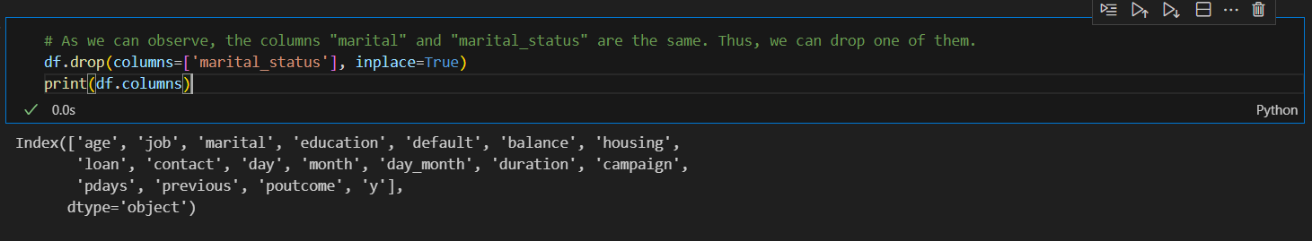
After dropping the redundant column
After dropping the column “marital_status”, our columns look like this:

Slide 4
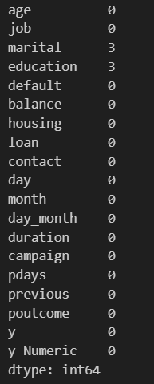
Checking of null values
Output:

Slide 5
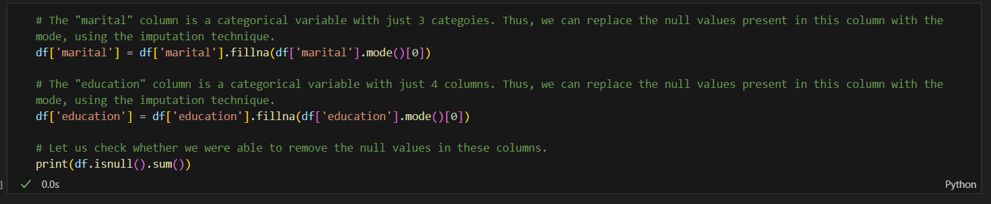
Usage of Imputation technique to replace the null values
The code for the same is pasted below.
The logic used to replace the null values with either mean, median or mode is mentioned as comments in the code.

Slide 6
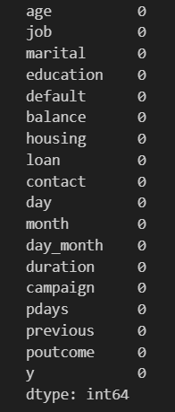
Post removal of null values
After removal of the null values, the columns look like this:

Slide 7
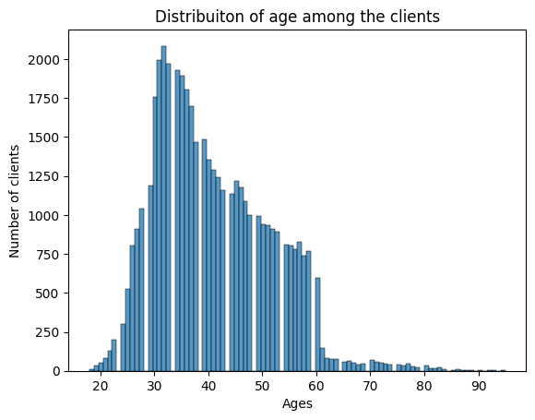
Distribution of age among the clients

Slide 8
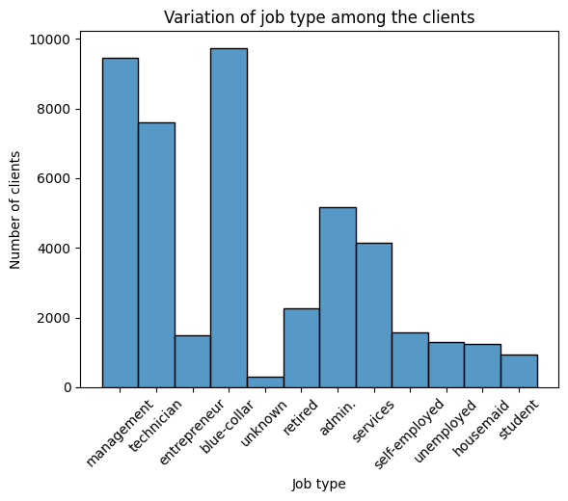
Variation of job type among the clients

Slide 9
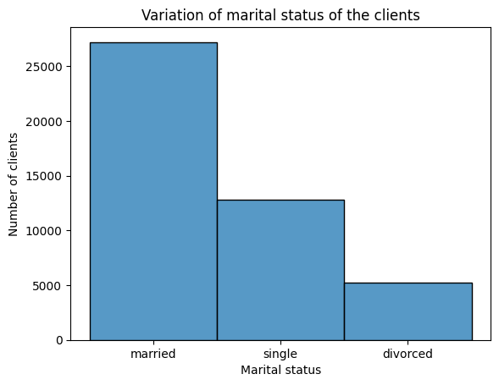
Variation of marital status among the clients

Slide 10
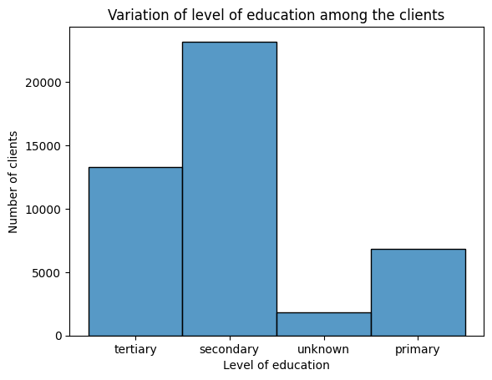
Variation of level of education among the clients

Slide 11
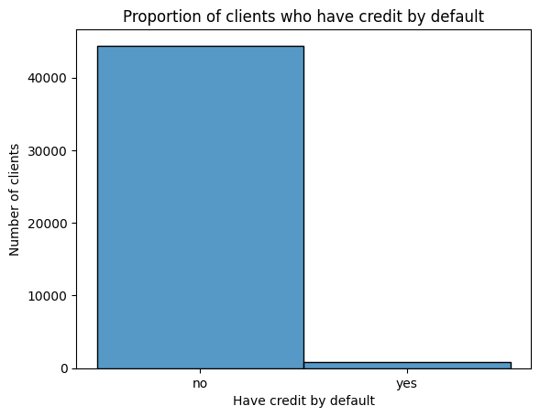
Proportion of clients who have credit by default

Slide 12
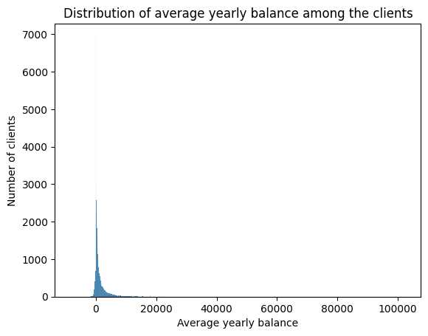
Distribution of average yearly balance among the clients

Slide 13
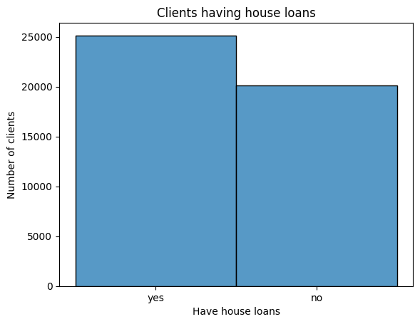
Clients having house loans

Slide 14
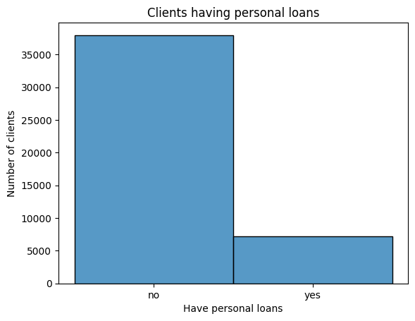
Clients having personal loans

Slide 15
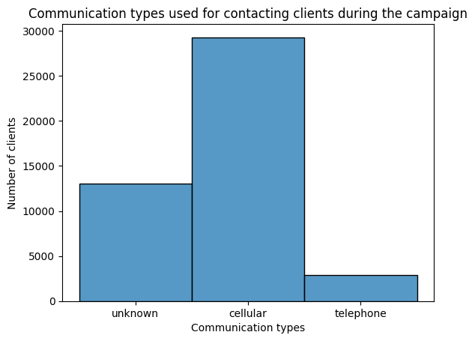
Variation of type of communication used for contacting clients during the campaign

Slide 16
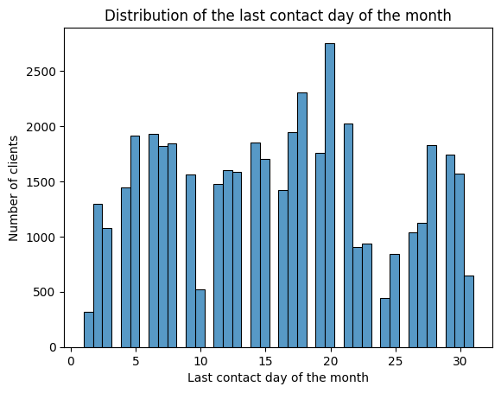
Distribution of the last contact day of the month

Slide 17
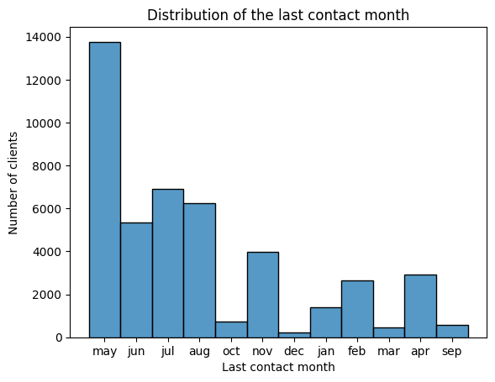
Distribution of the last contact month

Slide 18
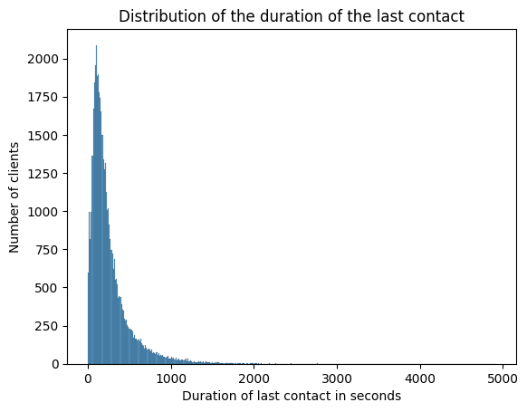
Distribution of the duration of the last contact

Slide 19
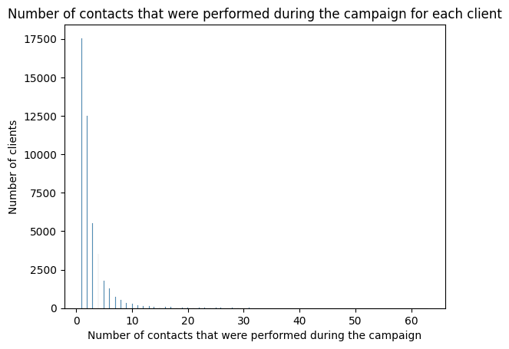
Number of contacts that were performed during the campaign for each client

Slide 20
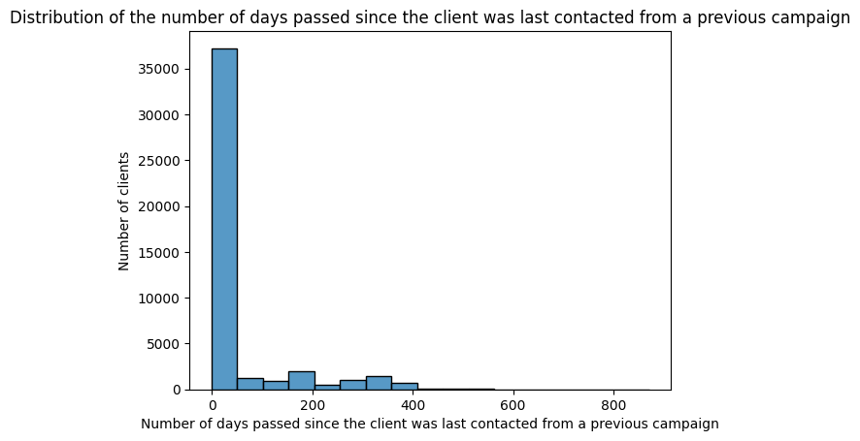
Distribution of the number of days passed since the client was last contacted from a previous campaign

Slide 21
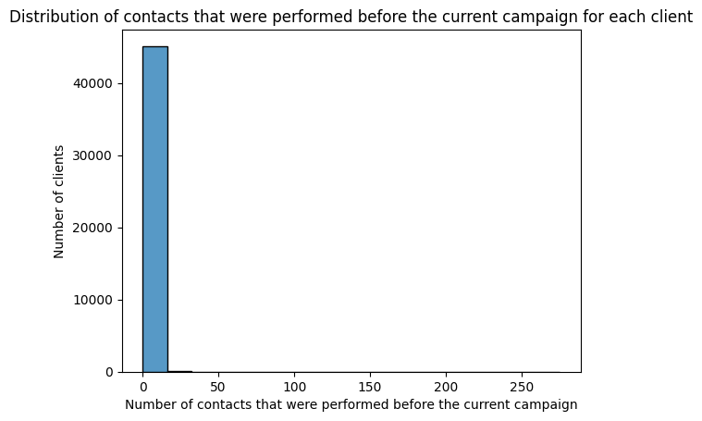
Distribution of contacts that were performed before the current campaign for each client

Slide 22
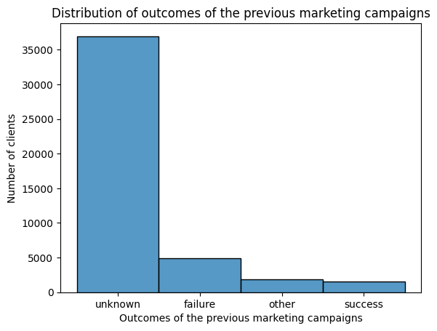
Distribution of outcomes of the previous marketing campaigns

Slide 23
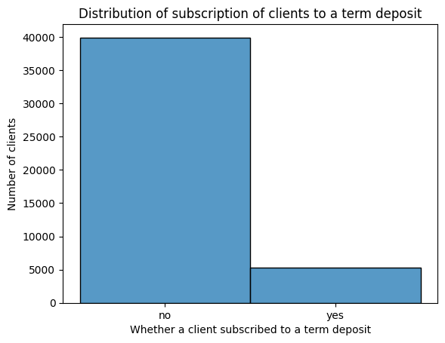
Distribution of subscription of clients to a term deposit

Slide 24
Modification of the target variable column (y)
The “y” column is a categorical variable having two categories “yes” and “no”.
Thus, it is not possible to capture its correlation with the numeric variables in a correlation matrix.
Thus, I have added a new column, which is a numeric variable, named as “y_Numeric” and encoded “yes” as 1 and “no” as 0.
Code used is: df['y_Numeric'] = df['y'].map({"yes":1, "no":0})
Now, its correlation with the numeric variables can be captured, which is shown in the next slide in a correlation matrix.

Slide 25
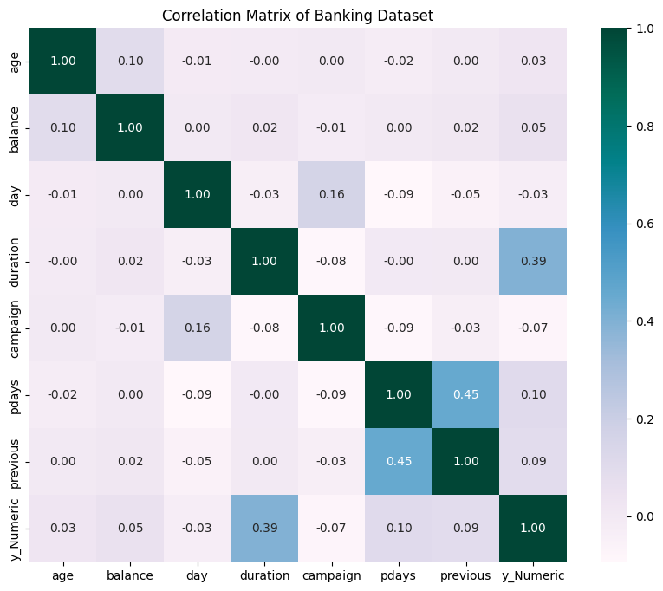
Correlation matrix of the dataset

Slide 26
Predictions that can be made using the correlation matrix
Negligible correlation between age and subscription of clients to a term deposit.
Negligible correlation between average yearly balance and subscription of clients to a term deposit.
Negligible correlation between last contact day of the month and subscription of clients to a term deposit.
Low positive correlation between duration of the last contact and subscription of clients to a term deposit.

Slide 27
Predictions that can be made using the correlation matrix (continued)
Negligible correlation between number of contacts performed during this campaign for a client and subscription of clients to a term deposit.
Negligible correlation between number of days that passed by after the client was last contacted from a previous campaign and subscription of clients to a term deposit.
Negligible correlation between number of contacts performed before this campaign for a client and subscription of clients to a term deposit.

Slide 28
Relationships between variables not covered in the correlation matrix
The relationship between non numeric variables is not captured by the correlation matrix.
Thus, we need to use some other mathematical test to know the relation between any 2 non numeric variables.
I have used chi square test of independence as a test to know the same.

Slide 29
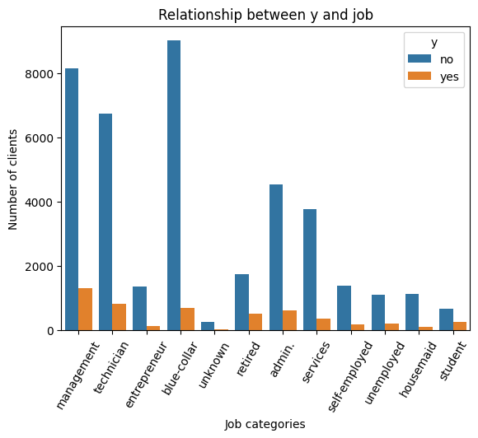
Relationship between job categories and subscription to a term deposit (y)

Slide 30
Continued….
Chi square characteristic is: 841.5452614002221
P-value: 2.2635164806103493e-173
Output of the code: Reject the null hypothesis. There is a significant association between the variables.
Thus, there is a significant relationship between job categories and subscription to a term deposit.

Slide 31
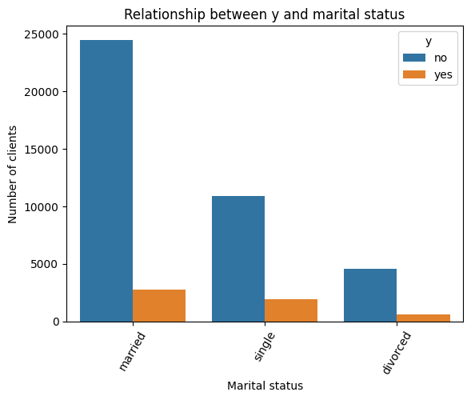
Relationship between marital status and subscription to a term deposit (y)

Slide 32
Continued…..
Chi-square statistic: 196.17206575615654
P-value: 2.5221863401197422e-43
Output of the code: Reject the null hypothesis. There is a significant association between the variables.
Thus, there is a significant relationship between marital status and subscription to a term deposit.

Slide 33
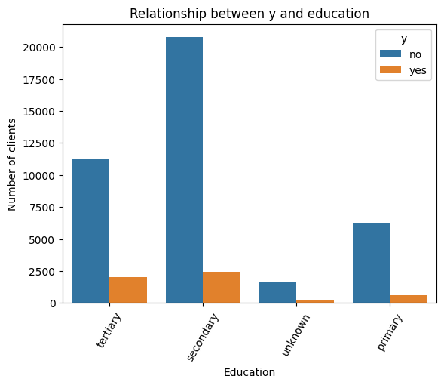
Relationship between education and subscription to a term deposit (y)

Slide 34
Continued….
Chi-square statistic: 238.43038031391868
P-value: 2.079369947995951e-51
Output of the code: Reject the null hypothesis. There is a significant association between the variables.
Thus, there is a significant relationship between education and subscription to a term deposit.

Slide 35
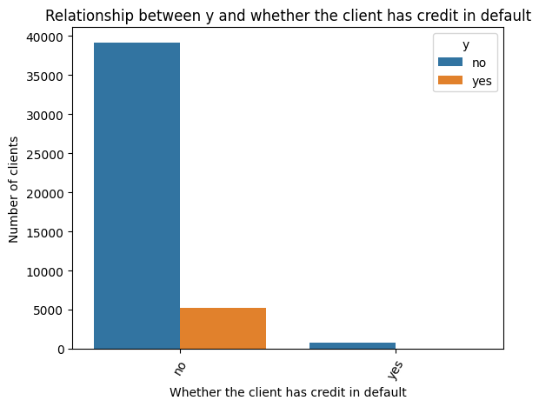
Relationship between having credit in default and subscription to a term deposit (y)

Slide 36
Continued……..
Chi-square statistic: 22.268639949059025
P-value: 2.3704645045981514e-06
Output of the code: Reject the null hypothesis. There is a significant association between the variables.
Thus, there is a significant relationship between having credit in default and subscription to a term deposit.

Slide 37
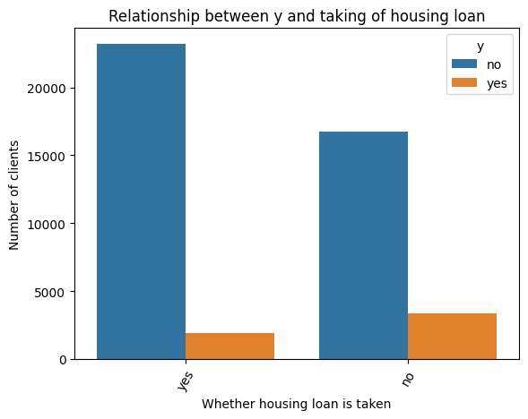
Relationship between having a housing loan and subscription to a term deposit (y)

Slide 38
Continued……
Chi-square statistic: 878.3448825348537
P-value: 5.005490373278558e-193
Output of the code: Reject the null hypothesis. There is a significant association between the variables.
Thus, there is a significant relationship between having a house loan and subscription to a term deposit.

Slide 39
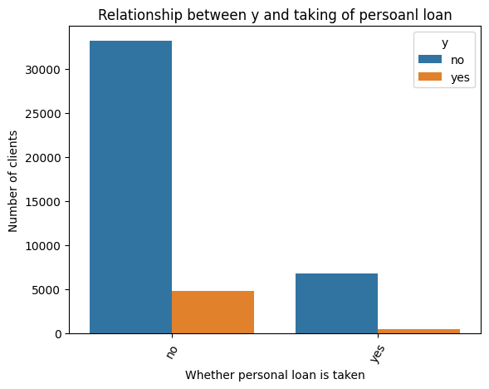
Relationship between having a personal loan and subscription to a term deposit (y)

Slide 40
Continued………..
Chi-square statistic: 210.27814514589792
P-value: 1.1944902411150737e-47
Reject the null hypothesis: There is a significant association between the variables.
Thus, there is a significant relationship between having a personal loan and subscription to a term deposit.

Slide 41
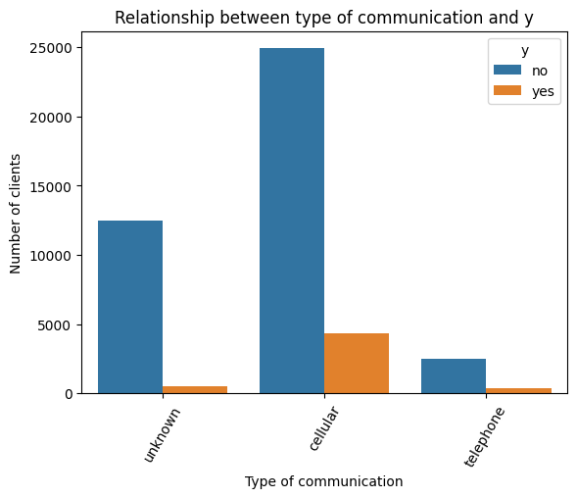
Relationship between type of communication used and subscription to a term deposit (y)

Slide 42
Continued………..
Chi-square statistic: 1037.6674151454113
P-value: 4.7139370187160045e-226
Reject the null hypothesis: There is a significant association between the variables.
Thus, there is a significant relationship between type of communication used and subscription to a term deposit.

Slide 43
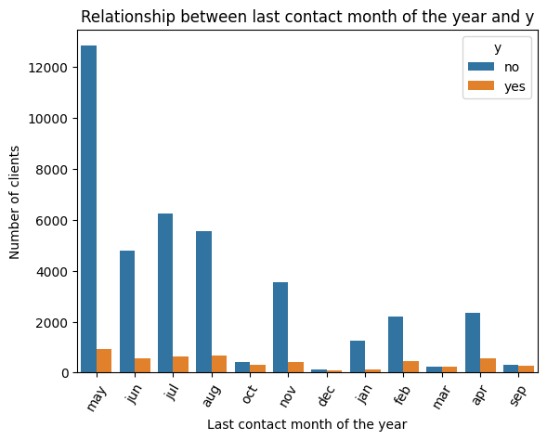
Relationship between last contact month of the year and subscription to a term deposit (y)

Slide 44
Continued…….
Chi-square statistic: 3058.3353989766065
P-value: 0.0
Reject the null hypothesis: There is a significant association between the variables.
Thus, there is a significant relationship between last contact month of the year and subscription to a term deposit.

Slide 45
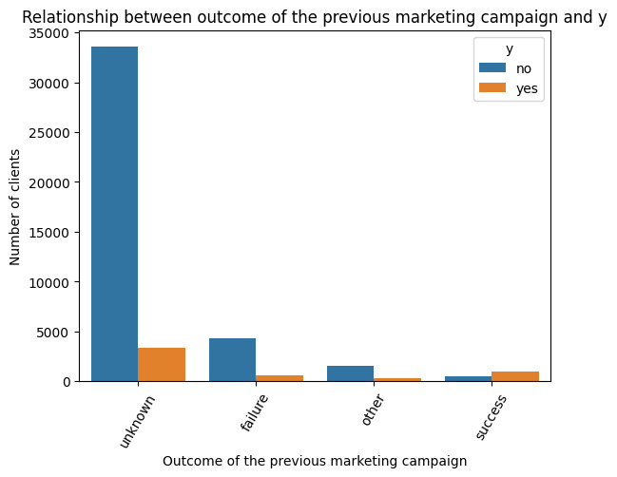
Relationship between outcome of the previous marketing campaign and subscription to a term deposit (y)

Slide 46
Continued……….
Chi-square statistic: 4400.2843429105305
P-value: 0.0
Reject the null hypothesis: There is a significant association between the variables.
Thus, there is a significant relationship between outcome of the previous marketing campaign and subscription to a term deposit.

